Slide 1
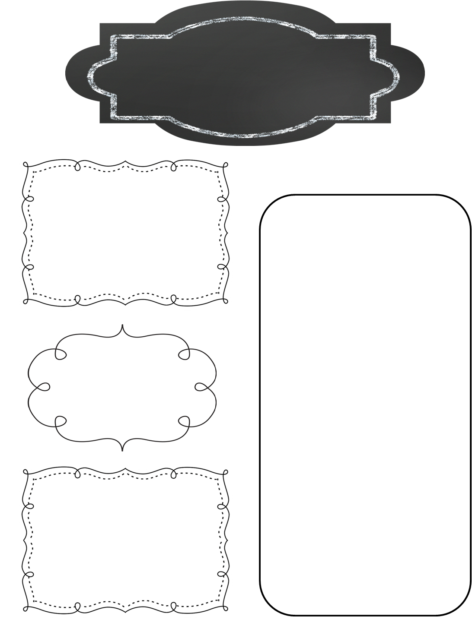
A Peek at This Week in…
Mrs. McFarland’s Class
Week of February 24th
Reminders
Our reading test format has changed as well. Our weekly tests will assess how well students have mastered the skills and strategies for the week, not the comprehension and vocabulary of the specific story read for the week. I will give the same grammar test because I want to be able to get a separate grammar grade.
Math (McFarland)
Ch. 8—Fractions
Simplifying fractions
Least common multiple
Comparing fractions
Fractions as decimals
Reading (McFarland)
Unit 3, L#13 (See the skills & strategies sheets for the unit from last week.)
Tests this Thursday!!
Hall of Presidents was a huge success! The students did an amazing job, and I am so proud of them! Thank you to all the parents and guardians who helped their students prepare for their role. Thank you for attending!
Spelling (McFarland)
VCCCV pattern
Test this Thursday
Language Arts/Writing (McFarland)
Upcoming Events
Regular and Irregular Verbs
Daily Proofreading
Persuasive Letter—Business style format
Monday, March 2nd: Yearbook orders are due
Thursday, March 5th: Math & Science Night 6:00-7:15p
Saturday, March 7th: NM Foundation dinner
Monday, March 16th: IAR testing begins and goes through the 23rd
Wednesday, March 18th: End of 3rd quarter
Science/ Social Studies (Eldridge)
Science: N/A
Social Studies: Ch. 9, L#3 & #4

